Slide 1
COVID-19 STATISTICAL VISUALIZATION
By
Shreejaa Talla
Harshitha Tirumani
CS Department

Slide 2
Contents:
Motivation
Problem Statement
Research
Objectives
Tools Used
Project and its Outcomes
Data
Data Cleaning
Data visualizations
Challenges
Conclusion
Future Scope
References

Slide 3
Motivation
Covid-19 outbreak has put the entire world to stop.
It is a new emerging issue so, to get updates we need to go different websites and check but by our website we can get the updates which keeps changing accordingly and give us live updates from world.
To have a clear and quick understanding information in an accurate manner.
This could be achieved by data visualization tools and techniques.

Slide 4
Problem Statement
As cases of covid-19 proliferate across the globe, so has data associated with it. This includes information on the number of affected patients, the number of people they are likely to infect, equipment that is available for healthcare workers, as well as the death and recovery rates, among others.
To make people aware, this data needs to be efficiently conveyed to people, since in the event of a pandemic like this, intuition cannot substitute for facts to understand how the spread is advancing. The approach that is needed should involve analysing, sharing and leveraging data.
Here, visualizing the data can help explain the developing events in a clear and succinct way for people to interpret data well.

Slide 5
Research
Data Visualization Techniques:
Data visualization is a graphical representation of information and data. By using visual elements like charts, graphs, and maps, data visualization tools provide an accessible way to see and understand data.
Techniques:
Scatter plot: 2-D plot representing the joint variation of data items.
Box Plot: shows the distribution of large data and easily see outliers.
Sunburst Charts: Sunburst plots visualize hierarchical data spanning outwards radially from root to leaves.
Categorical Axes: to visualize categorical i.e. qualitative, nominal or ordinal data as opposed to continuous numerical data.
Bubble map: A bubble chart is a scatter plot in which a third dimension of the data is shown through the size of markers.

Slide 6
Objectives
This project is for Educational purposes and visualizing data.
It gives the statistical overview of
Covid spread all through the Us counties
Covid spread cases all over the world
Vaccinations progress throughout the world until recently
Better medication can be provided by the analysis of data, this will help the medical sector to reach out to more people.

Slide 7
Tools Used
Plotly plots
Plotly Dash

Slide 8
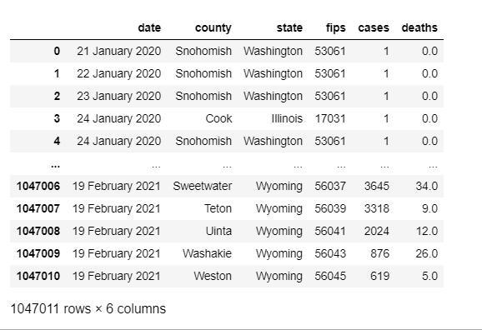
Project and outcomes
Data Description
Us_counties:

Slide 9
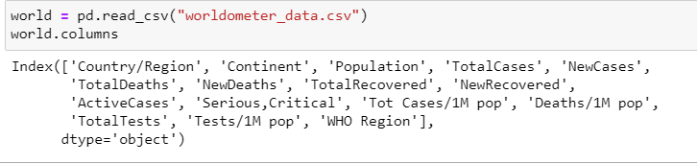
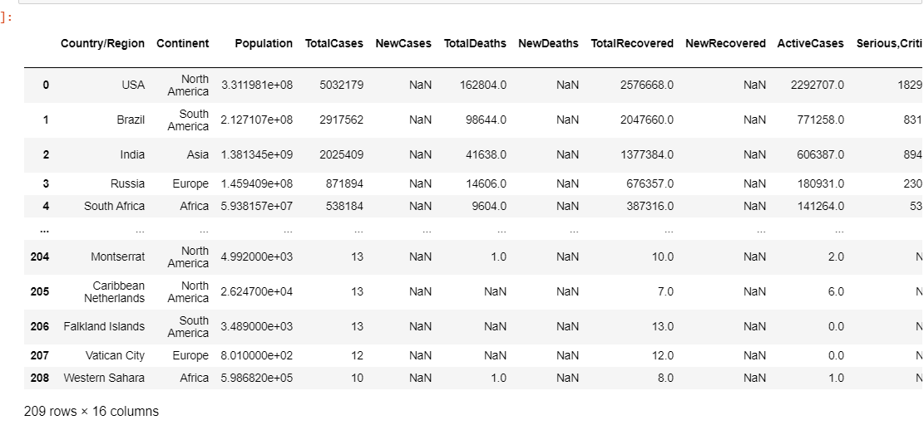
Worldometer_data:

Slide 10
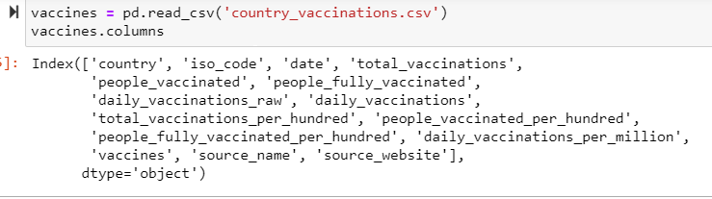
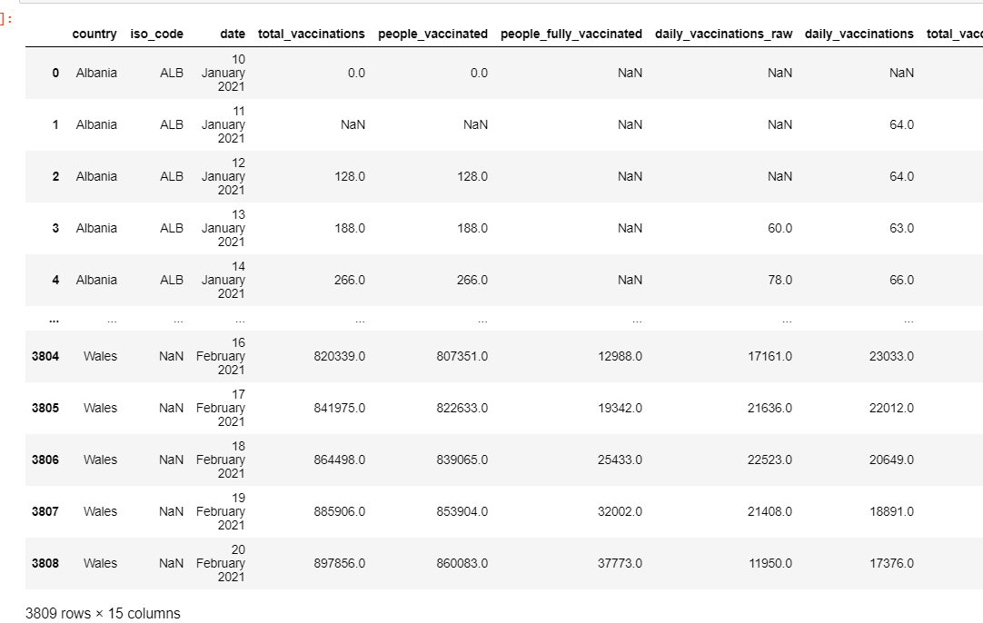
Country_vaccinations:

Slide 11
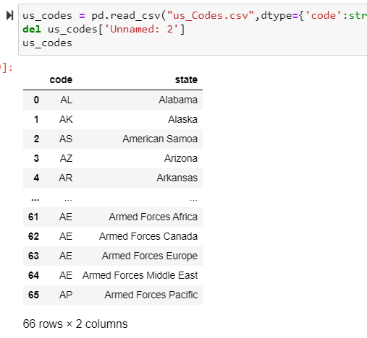
Us_codes:
United States Zip Codes (worldpostalcode.com)

Slide 12
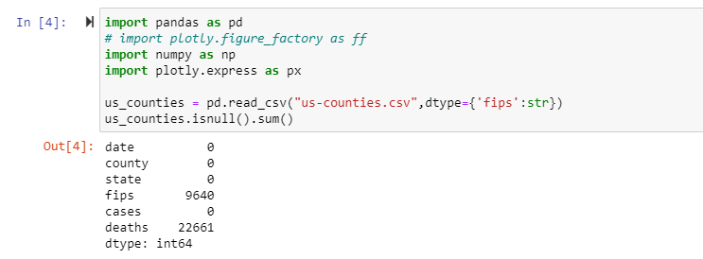
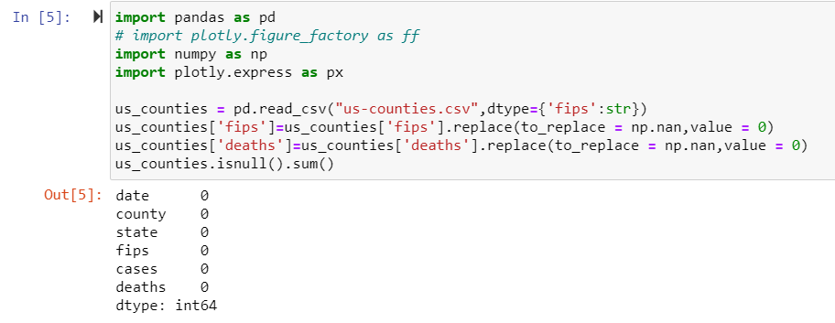
DATA CLEANING
US Counties data before and after cleaning

Slide 13
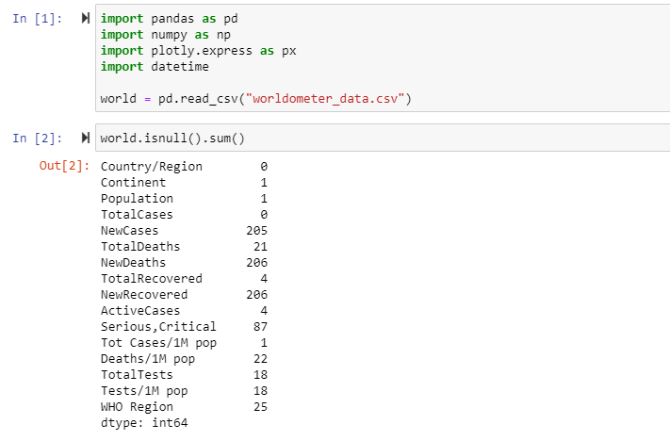
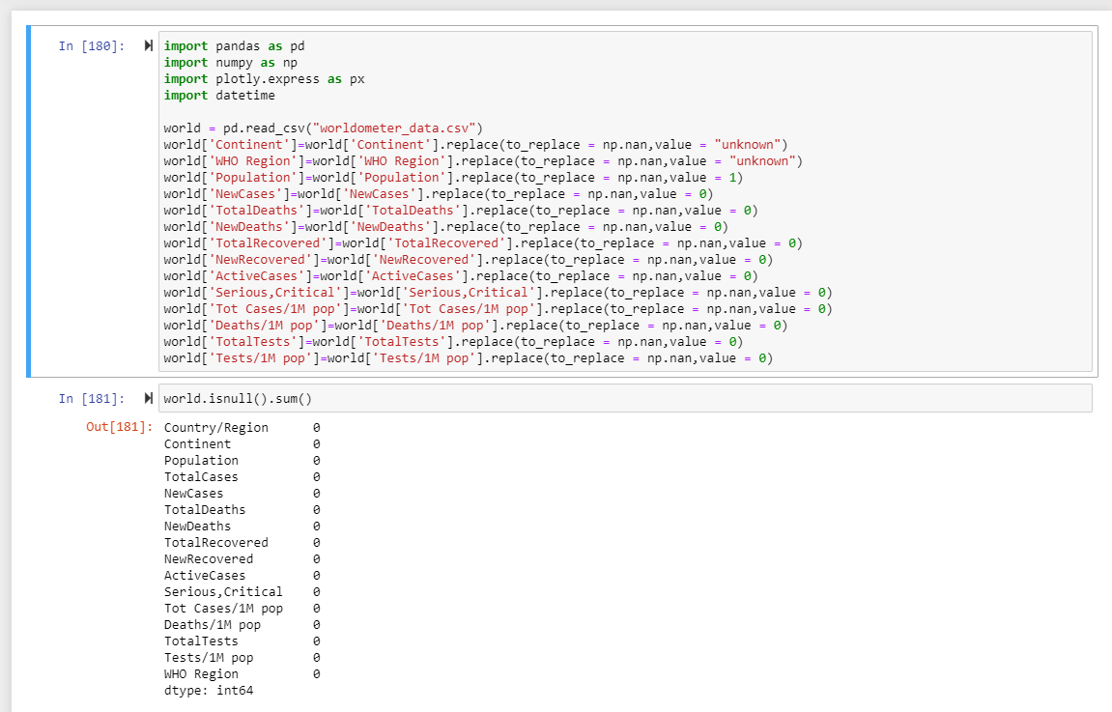
world_wide_cases data before and after cleaning

Slide 14
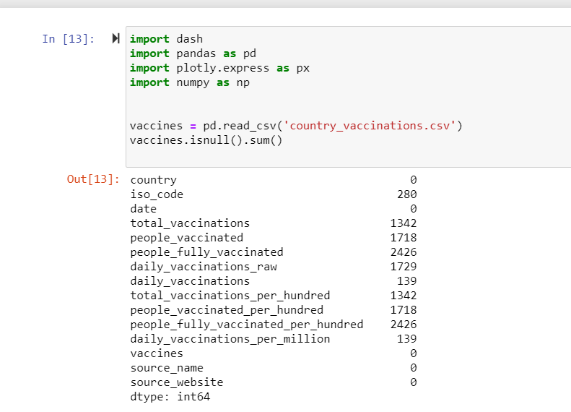
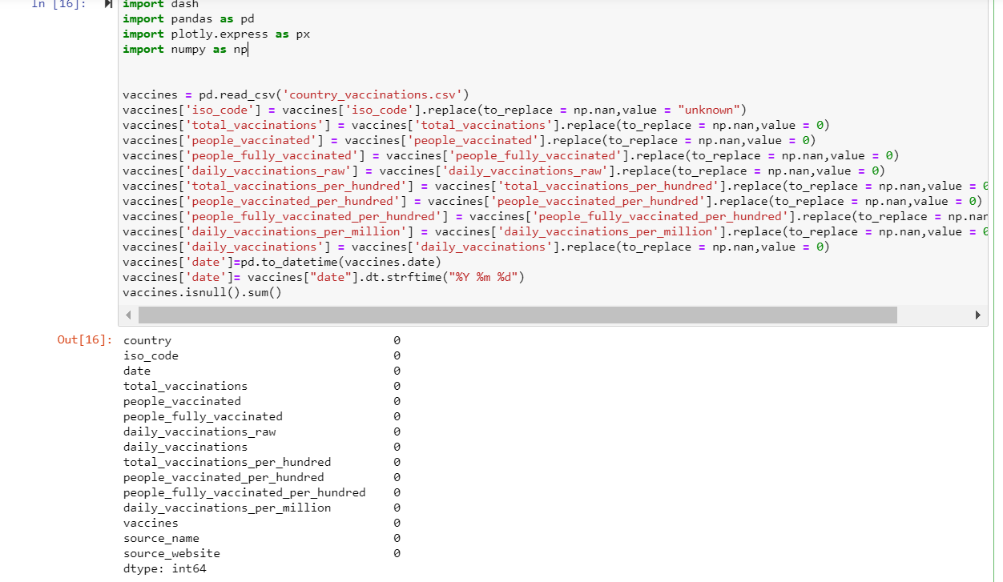
Country_Vaccinations data before and after cleaning

Slide 15
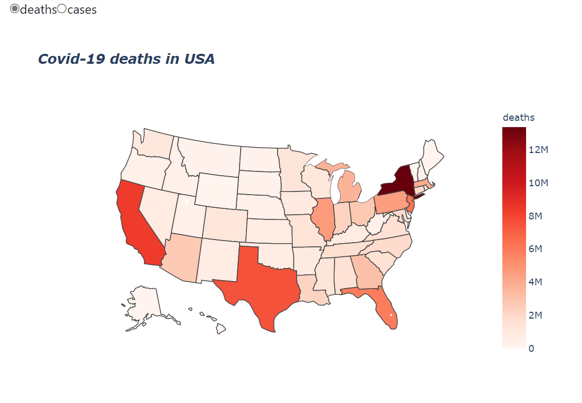
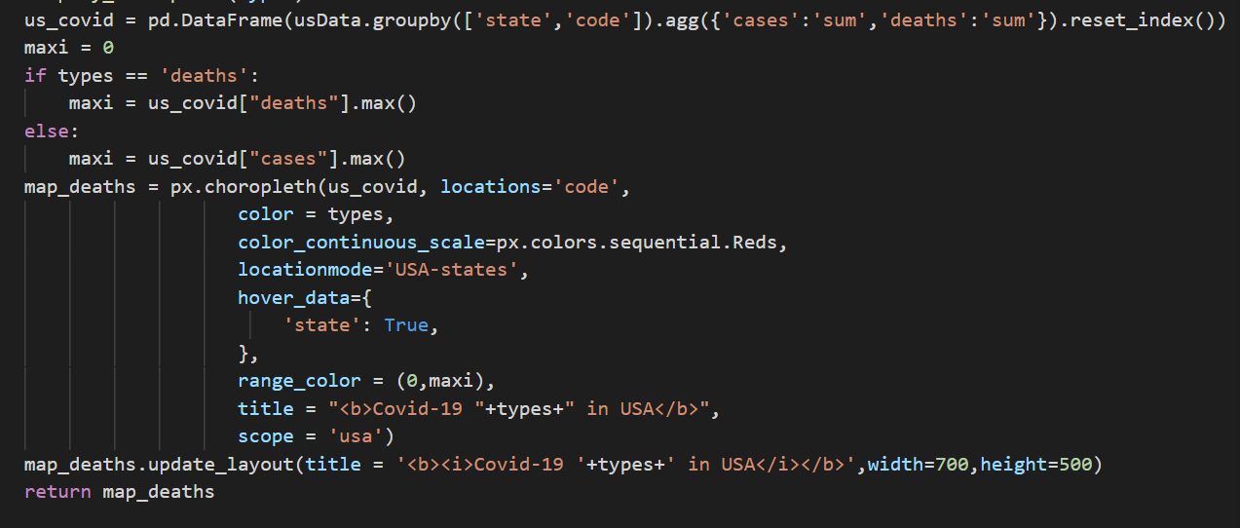
Data Visualizations:
COVID-19 DEATHS IN USA

Slide 16
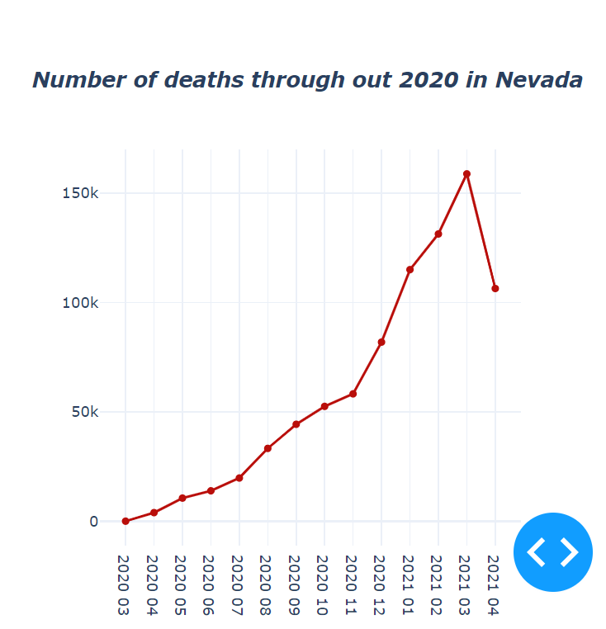
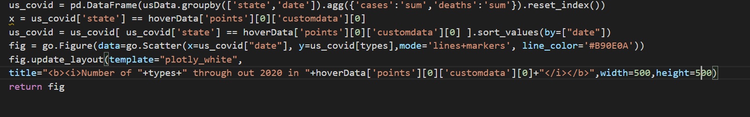
NUMBER OF DEATHS THROUGH OUT 2020 IN NEVADA

Slide 17
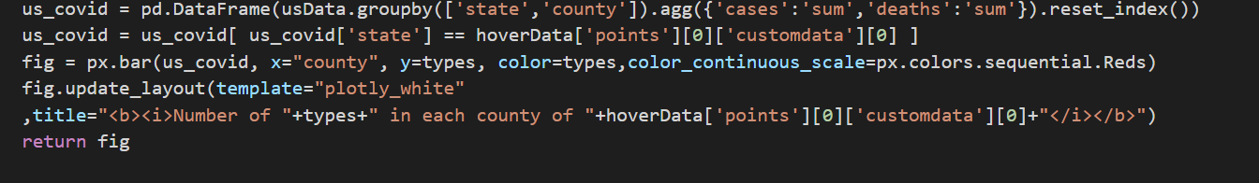
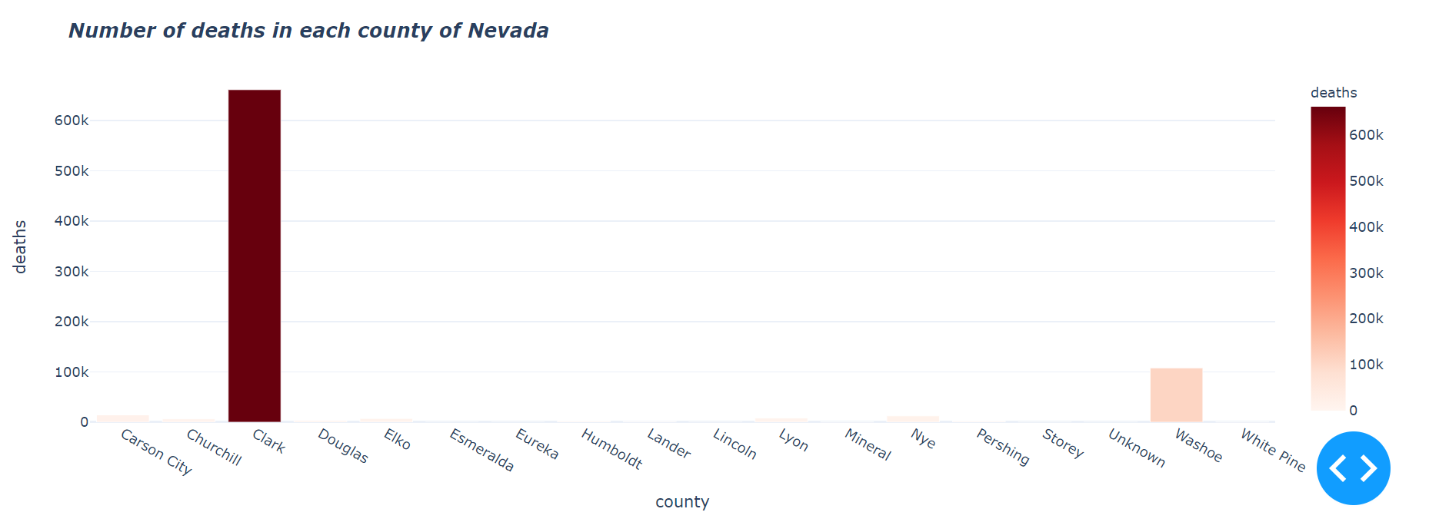
NUMBER OF DEATHS IN EACH COUNTY OF NEVADA

Slide 18
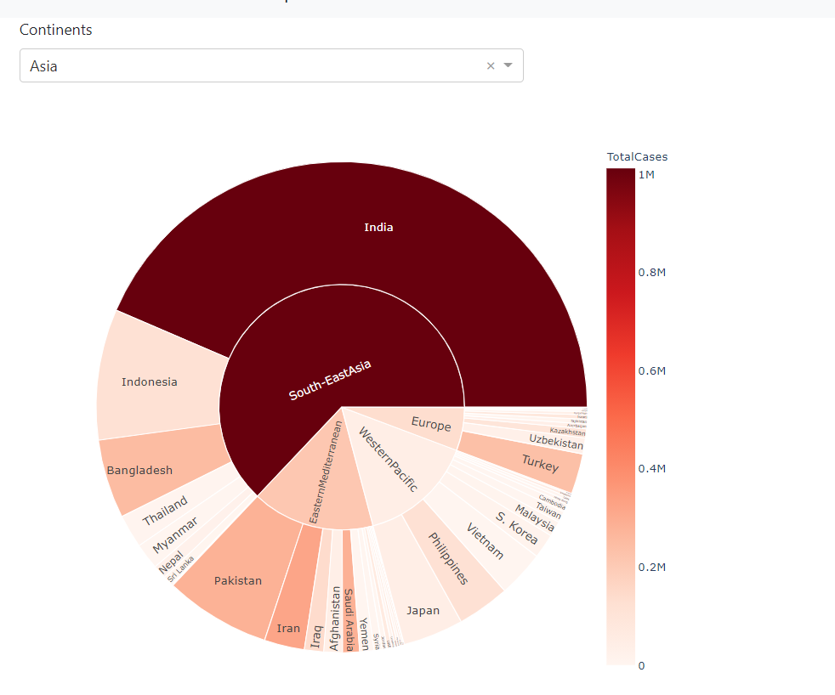
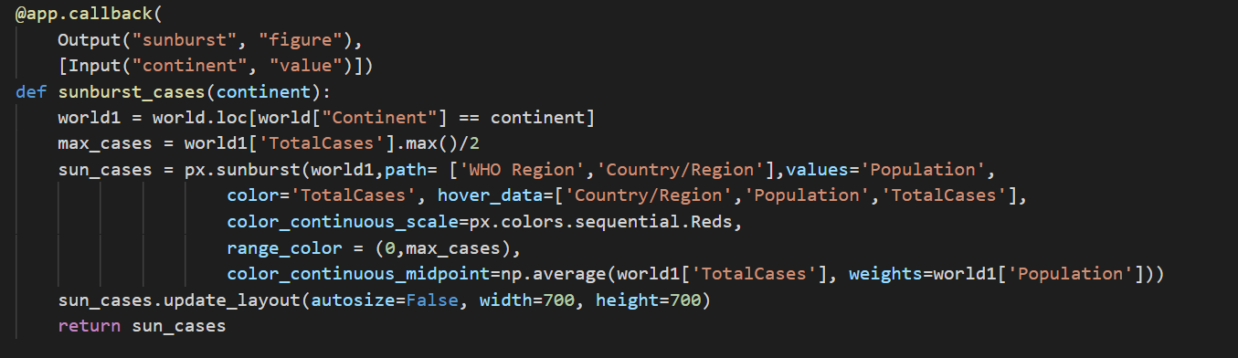
COUNTRIES AND CONTINENTS TOTAL CASES

Slide 19
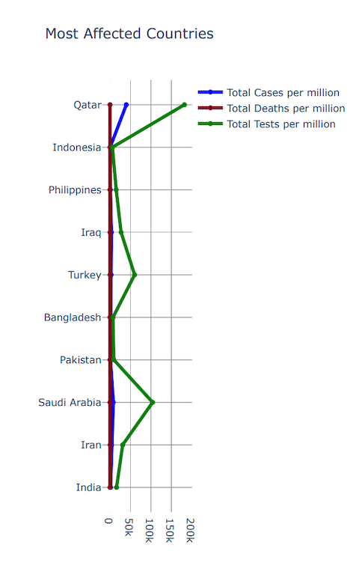
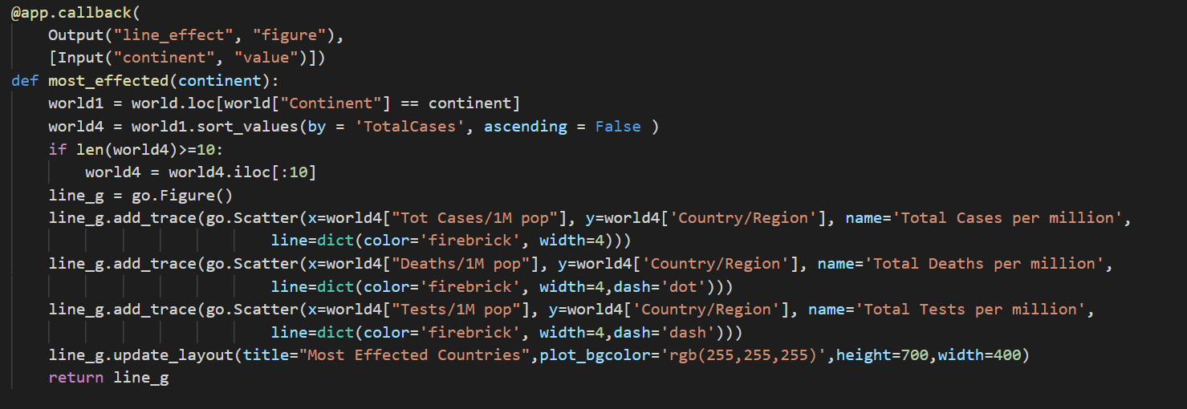
MOST AFFECTED COUNTRIES

Slide 20
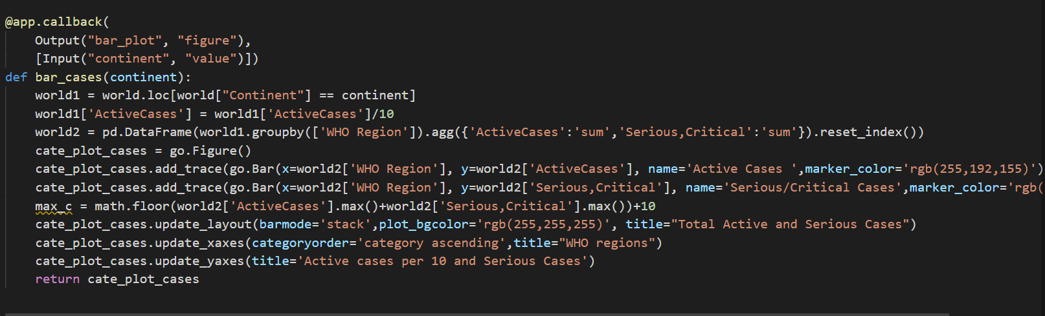
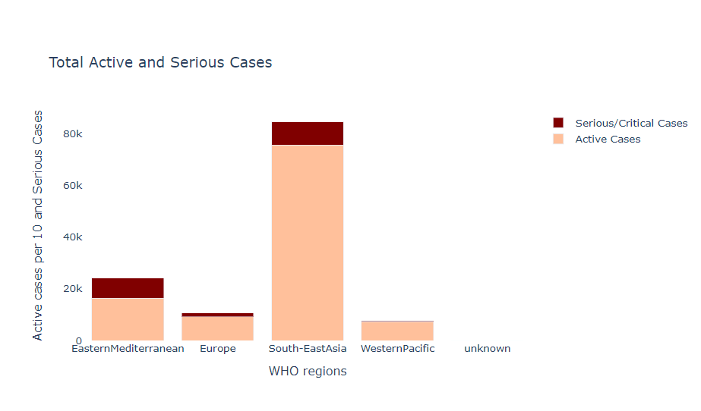
TOTAL ACTIVE AND SERIOUS CASES

Slide 21
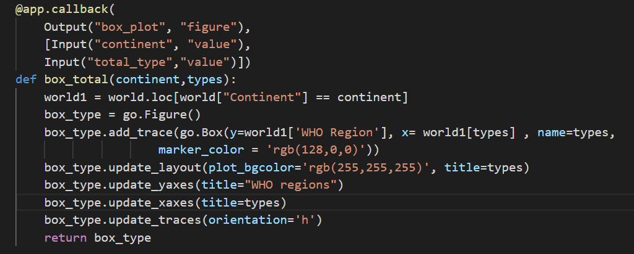
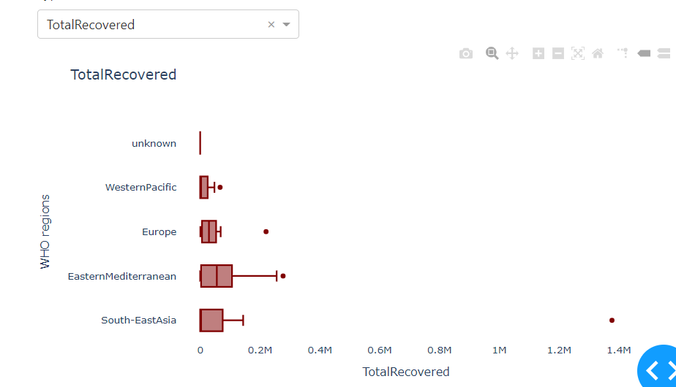
TOTAL RECOVERED

Slide 22
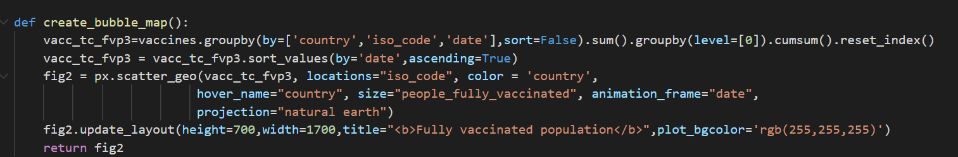
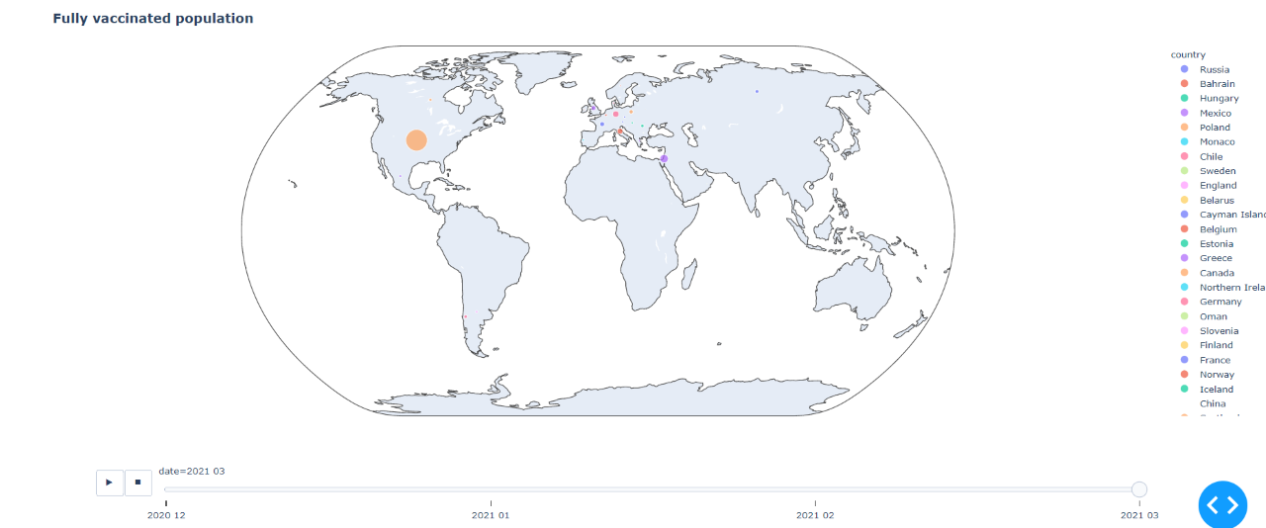
FULLY VACCINATED POPULATION

Slide 23
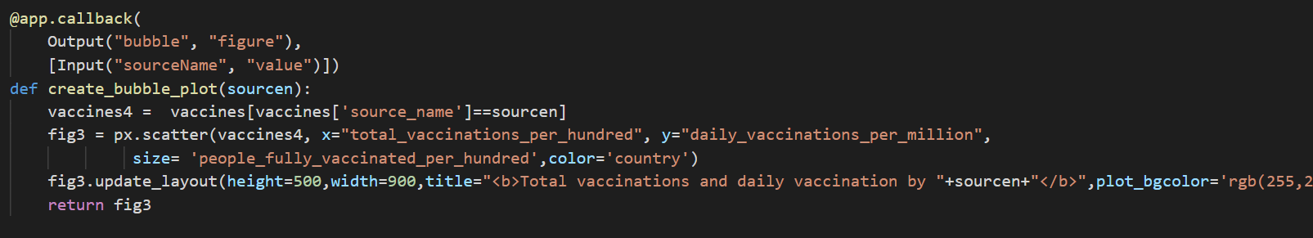
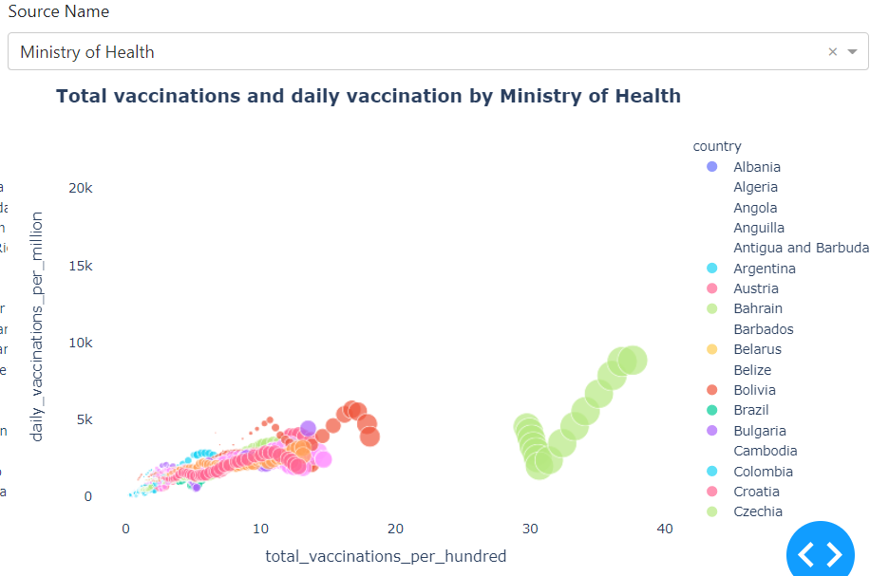
TOTAL VACCINATIONS AND DISPLAY VACCINATION BY MINISTRY OF HEALTH

Slide 24
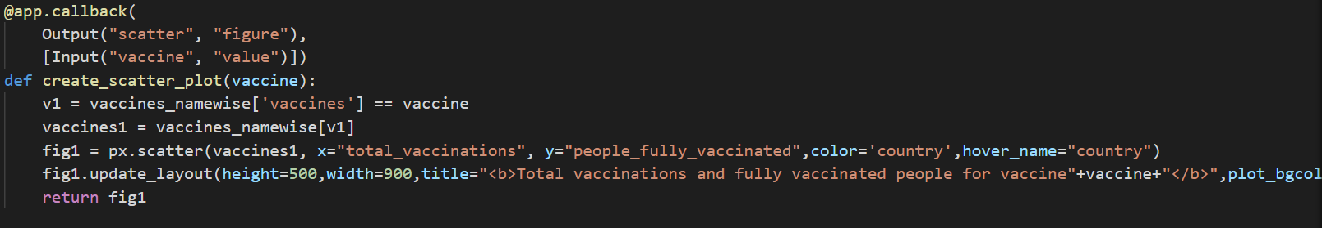
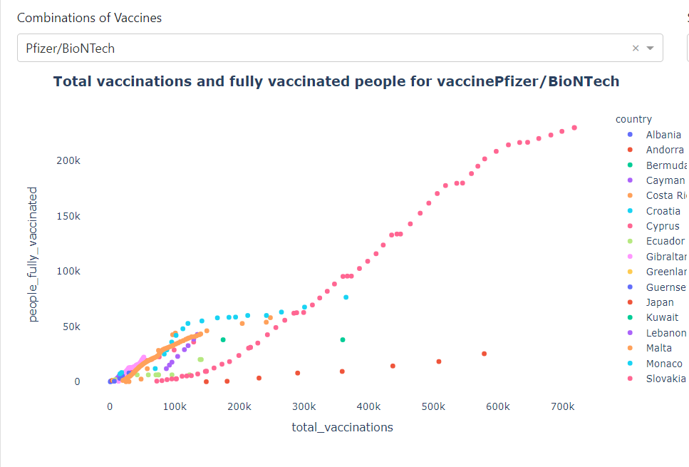
TOTAL VACCINATIONS AND FULLY VACCINATED PEOPLE FOR VACCINEPFIZER/BIONTECH

Slide 25
Challenges
The Us_counties data had missing value for state code which are used to plot choropleth graph.
Dynamic change of hover data in dash application.
To combine all dash applications into a single application using Navigation.

Slide 26
Demo

Slide 27
Conclusion
In the world of Data where information is crucial in one way or the other we rely on the visual information to find useful patterns.
In this project we identified why data visualization is important for and what are the challenges and issues related to this. We also noted that interactivity of visualization is of utmost importance and good visualization tools should produce interactive visualization.
Used Different Data Visualization techniques to display data in different format so that it is easy to understand for everyone.

Slide 28
Future Scope
The visualization charts can be plugged into live data streams.which will help people have a clear understanding of the emerging events.
News ripple through markets ever faster. Less time is used to read each article and more automation is used to generate data and even news items.
It will be asked to make important decisions based on data.

Slide 29
References
Data Sets:
https://www.kaggle.com/fireballbyedimyrnmom/us-counties-covid-19-dataset
https://www.kaggle.com/gpreda/covid-world-vaccination-progress
Links:
https://plotly.com/python/bubble-charts/
https://plotly.com/python/sunburst-charts/
https://plotly.com/python/categorical-axes/
Deploy your Dash App | Dash for Python Documentation | Plotly

Slide 30
Thank you!

